Slide 1
Drinks & Delight :
Inventory Management System
Team D:
Maski Saijahnavi
Pushpraj Kaushik
Ritwik Sinha
Rohit Kumar
Sowrasree Banerjee

Slide 2
Epics & User Stories
EPIC :
As a beverage company (drink and delight) , we want to give Order of raw materials to supplier.
USER STORY: User story 1: as a system user, first we will add Supplier
User story 2: validate the login credentials of supplier.
User story 3: order will be given and supplier will manage the address of orders.

Slide 3
Epic : As a Beverages Company (Drink & Delight), we want to manage Raw Material Stock
User Stories :
As a System user, I want to update raw material stock to maintain the stock list.
As a System user, I want to check the current raw material stock.
As a System user, I want to search for a raw material in the stock list.

Slide 4
Epic : As a Beverages Company (Drink & Delight), we want to manage Product Stock
User Stories :
As a System user, I want to update product stock to maintain the stock list.
As a System user, I want to check the current product stock.
As a System user, I want to search for a product in the stock list.

Slide 5
EPIC : As a System user, I need to place an order for raw materials.
User Stories: 1.I will login using my supplier ID. 2. I shall get different raw material ID listed in the order. 3. I will verify the order and make payment.

Slide 6
EPIC : As a System user, I need to verify raw material order details.
User Stories: 1.I will login using my raw material ID. 2. I shall check the raw material list and then process the order. 3. I will inquire about unit price and quantity and get the total price.

Slide 7
EPIC:As a distributer I will place the order
USER STORIES:
I will login using my distributer ID.
As a distributer, I will select products from the list.
I will specify the quantity and I will place the order.

Slide 8
Epic : As a system user I need to perform Order processing.
User stories:
As a system user , I need to login in the system
I need to get information about all the recent orders
I need to send request for available product count
Based on the product count , I will start shipping the products to the distributor.

Slide 9
EPIC :As a system user I will manage the distributers
USER STORIES:
As a system user I will add distributer
I will update distributer
I will delete distributer.
I can view all the distributer.

Slide 10
Epic : As a distributor I need to manage my address.
User stories:
As a distributor I need to login into system.
The system will add, update or delete the address based on his request.
The system will send me message whether the address is deleted ,updated or added.

Slide 11
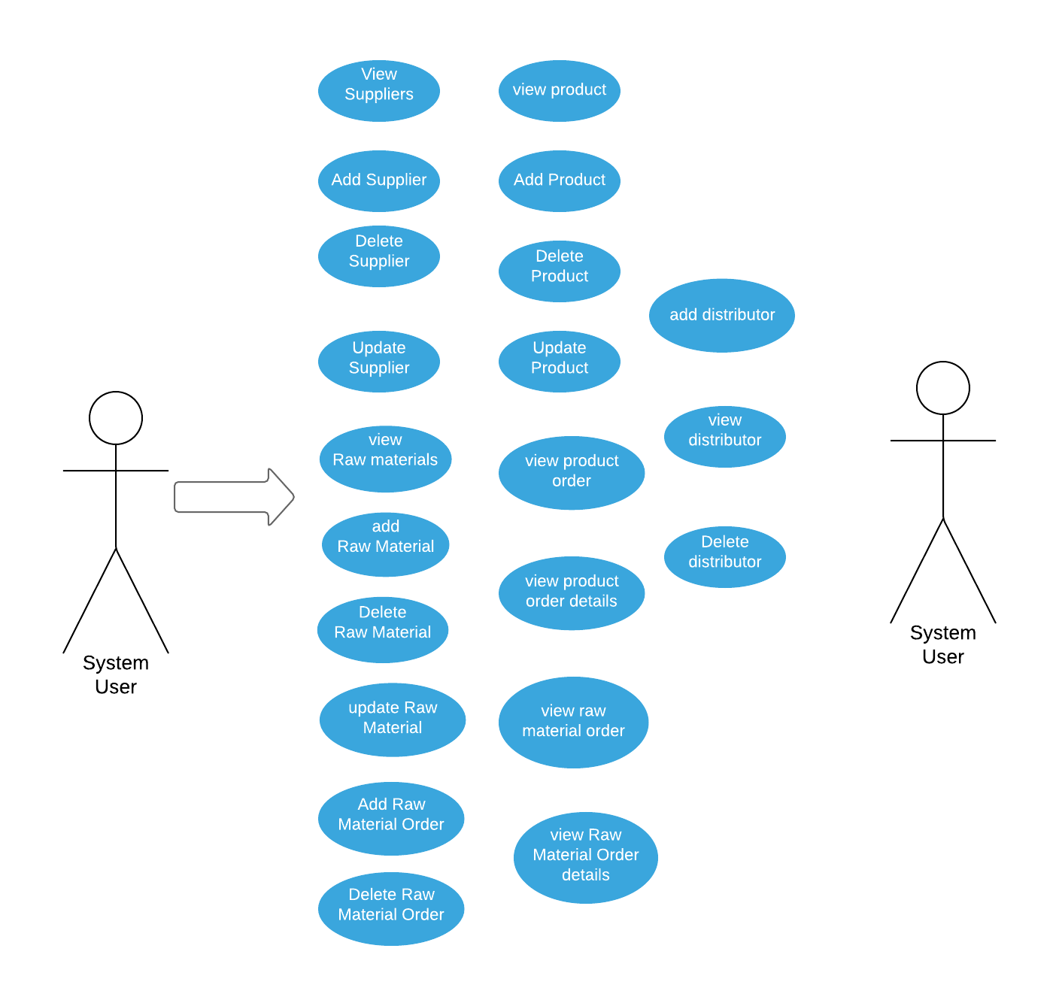
Use Case Diagram For System User

Slide 12
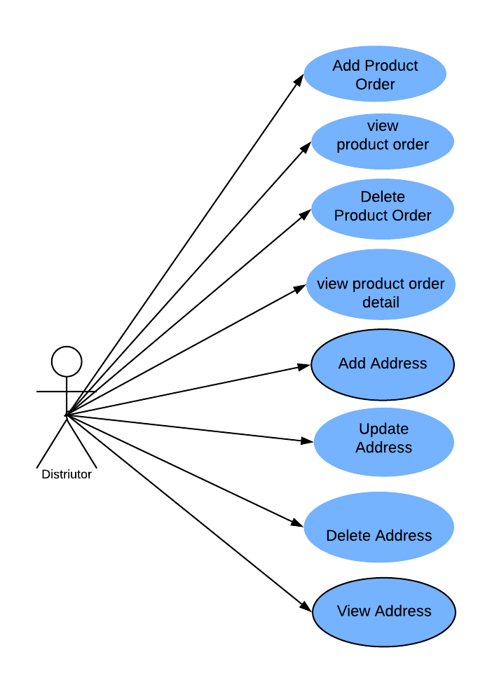
Use Case Diagram for Distributor

Slide 13
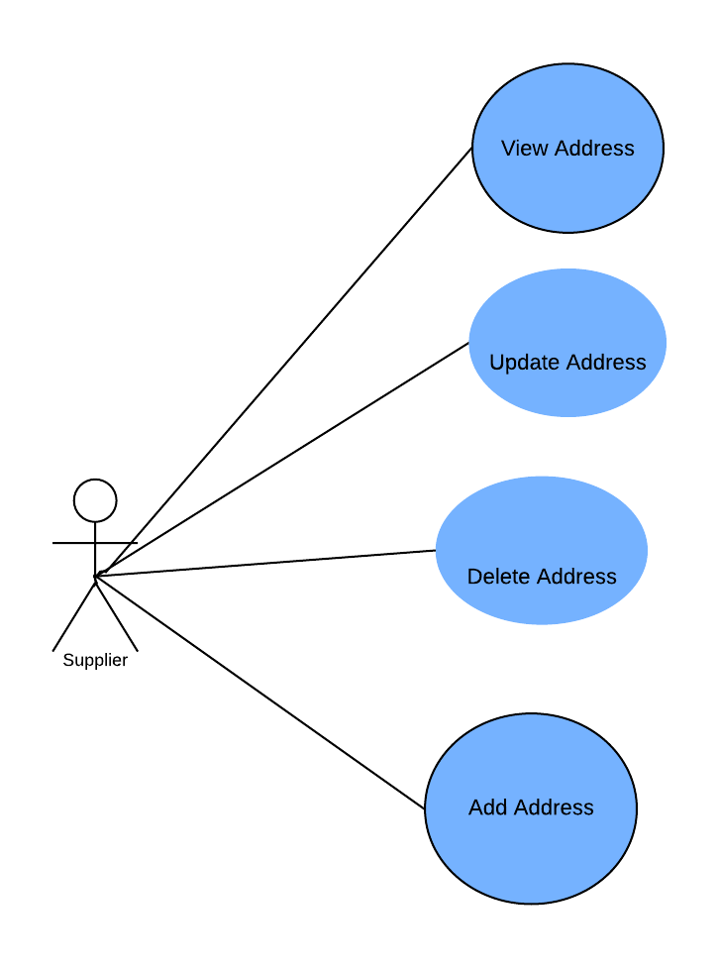
Use Case Diagram for Supplier

Slide 14
Highlights
Interface
Abstract methods
Various concepts of OOPS
Reflection
Summary comments
Serialization

Slide 15
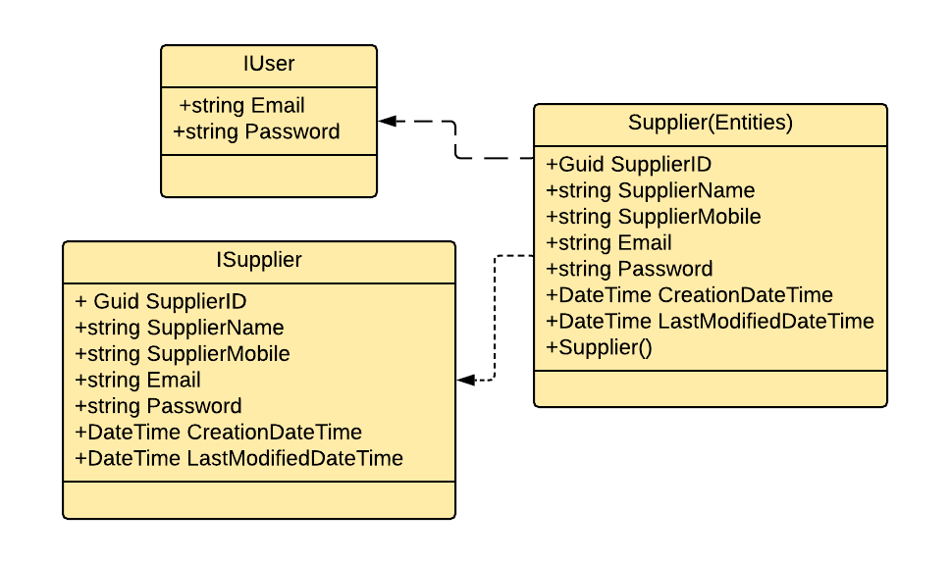
Class Diagram for Supplier Class

Slide 16
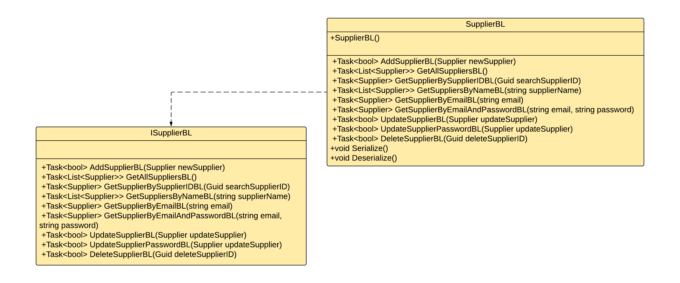
Class Diagram for Supplier Class

Slide 17
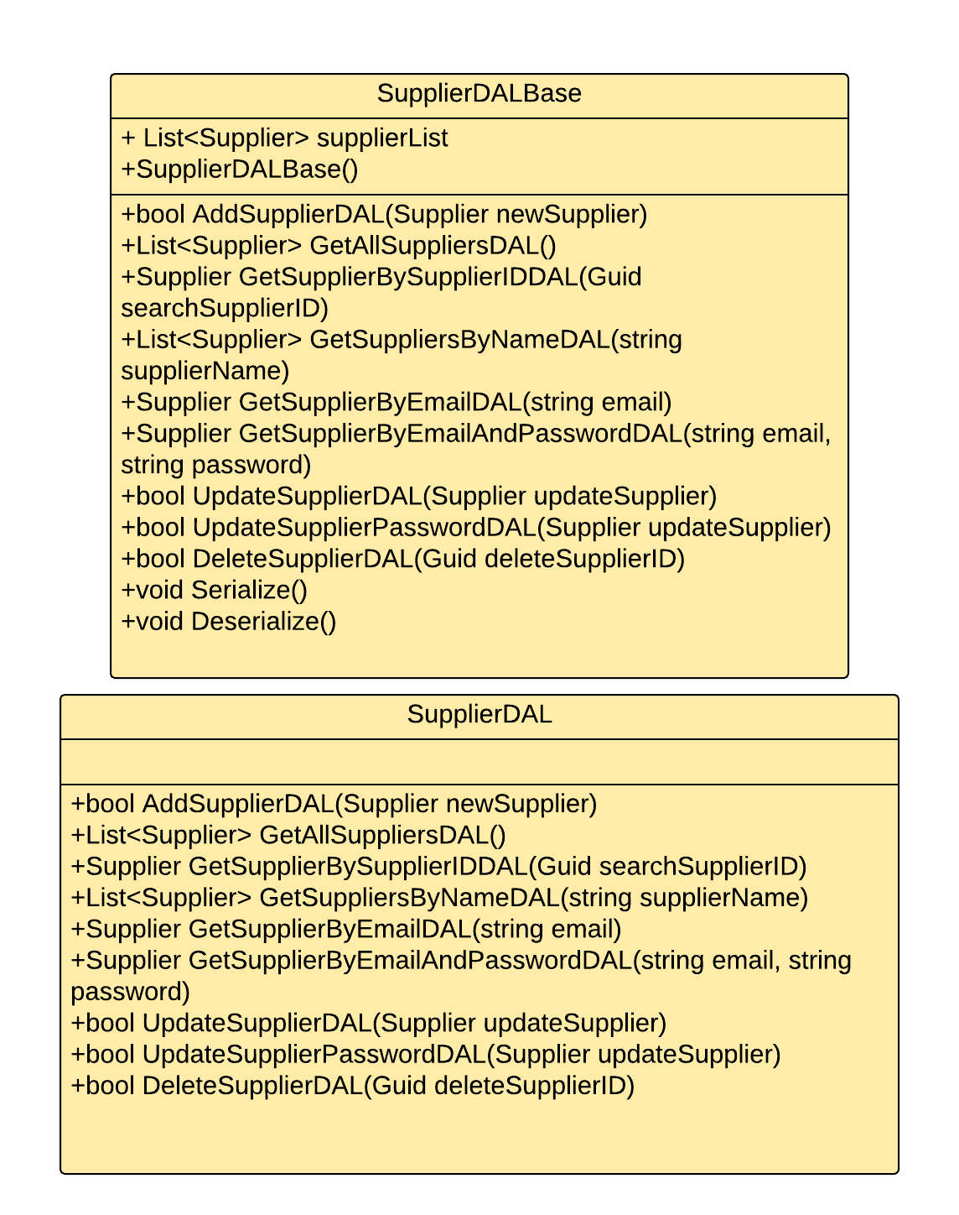
Class Diagram for Supplier Class

Slide 18
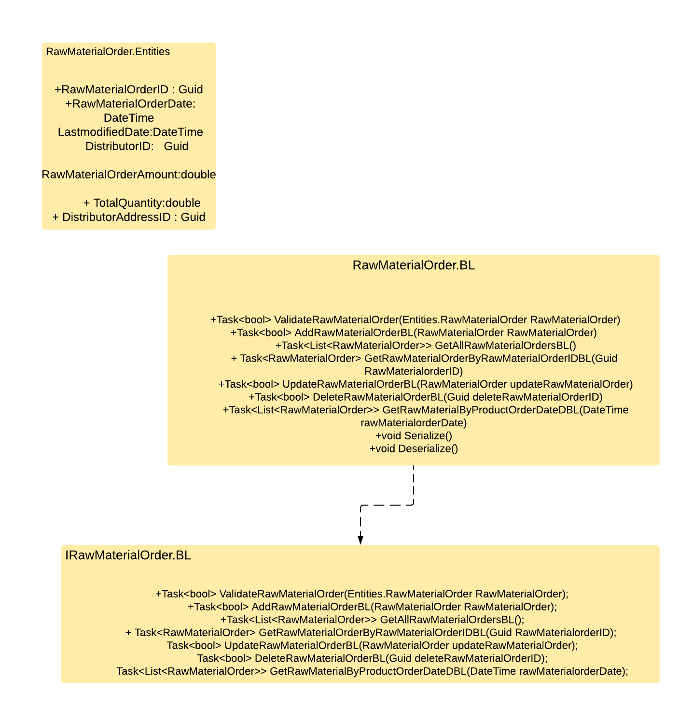
Class Diagram for RawMaterialOrderClass

Slide 19
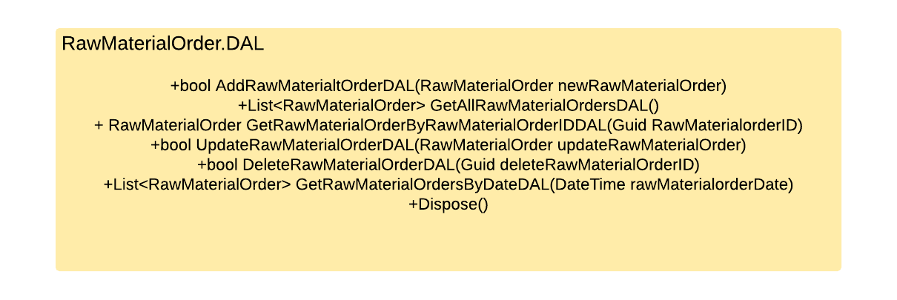
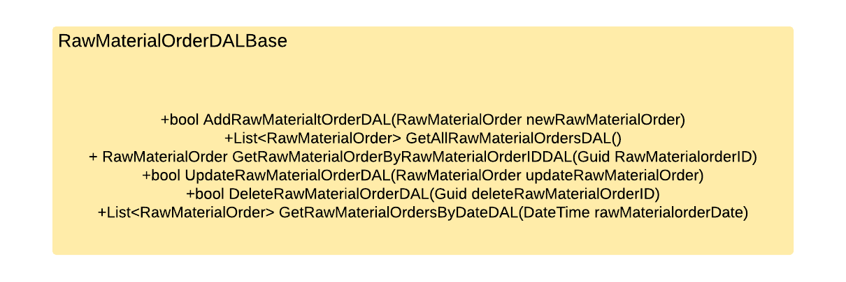

Slide 20
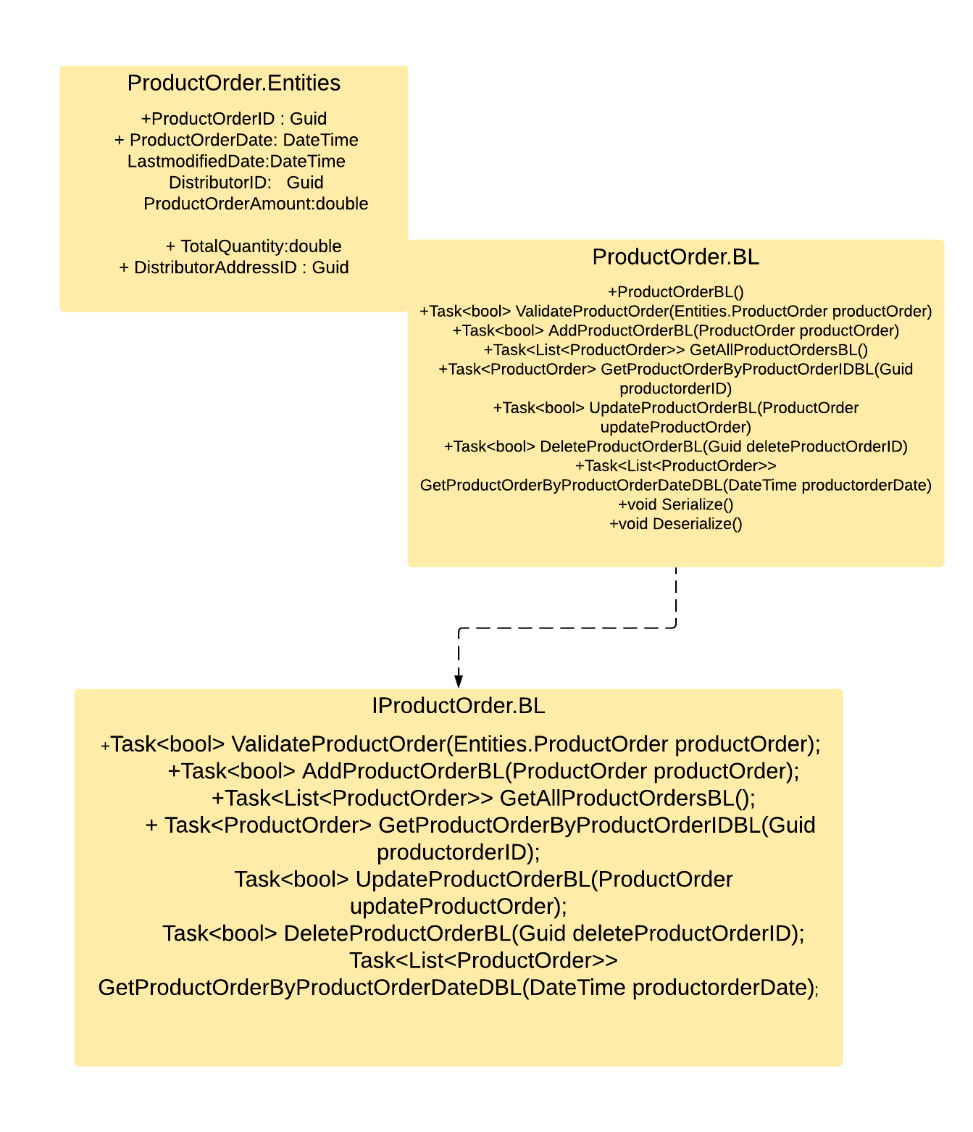
Class Diagram for Product Order Class

Slide 21
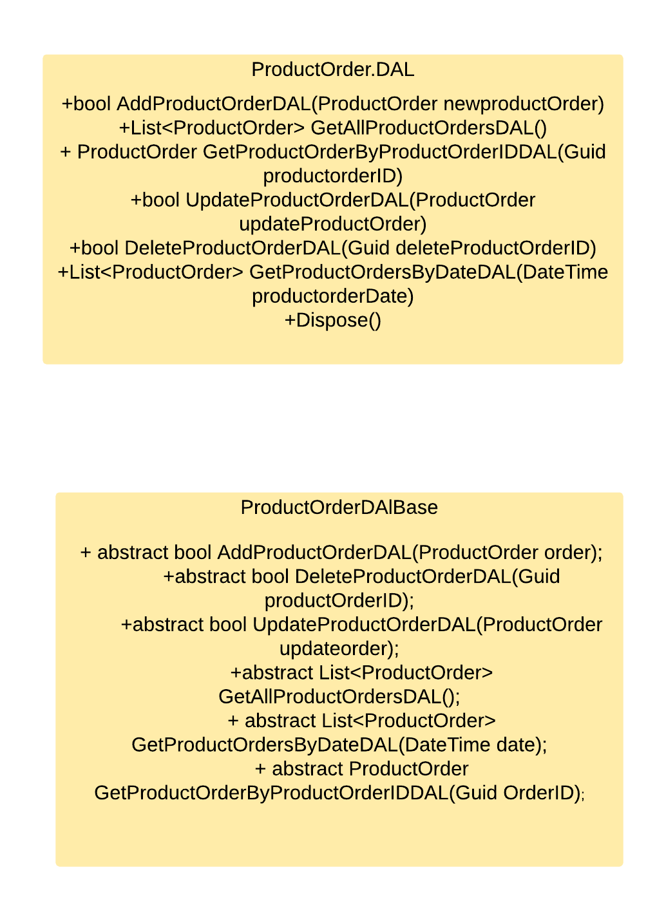
Class Diagram for ProductOrder Class

Slide 22
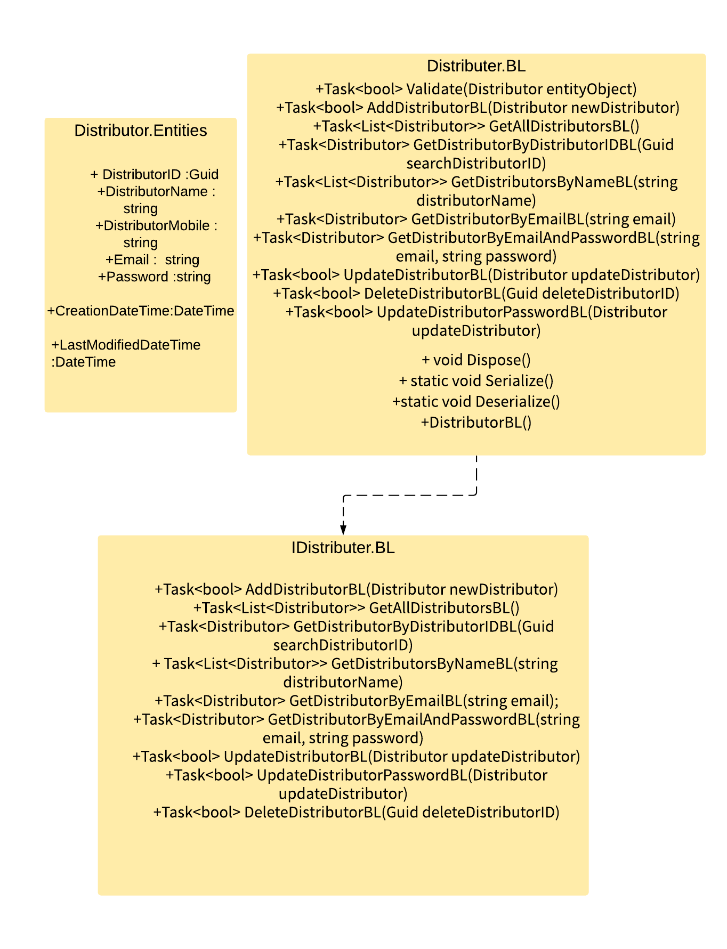
Class Diagrams
Class Diagram for Distributer Class

Slide 23
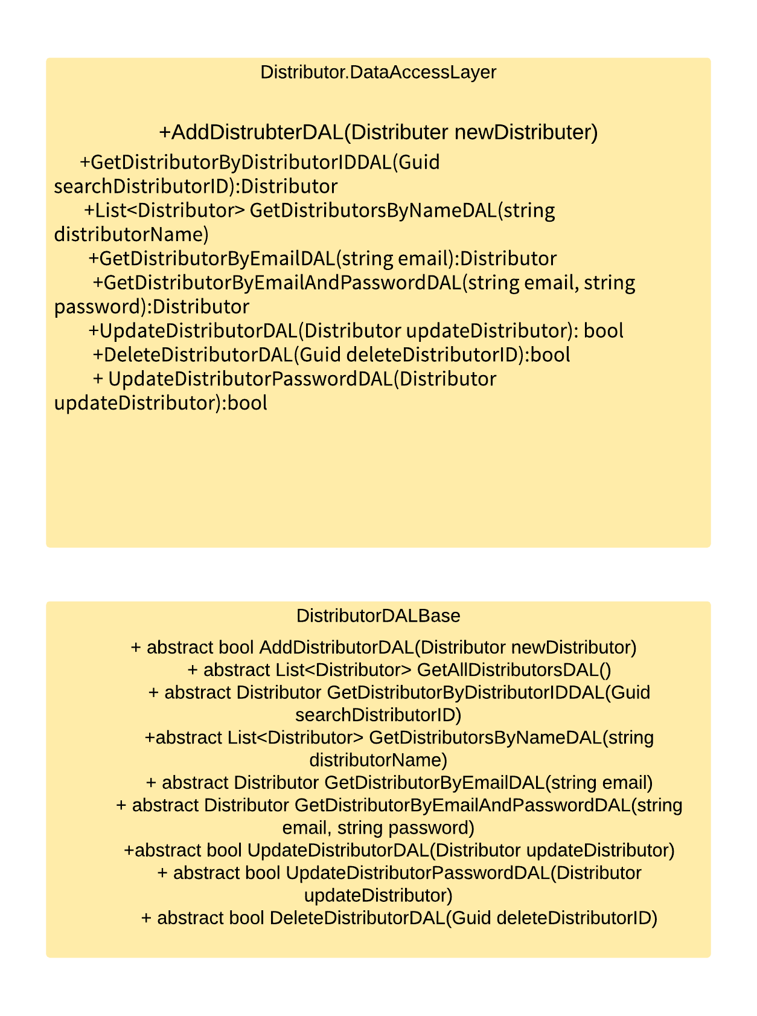

Slide 24
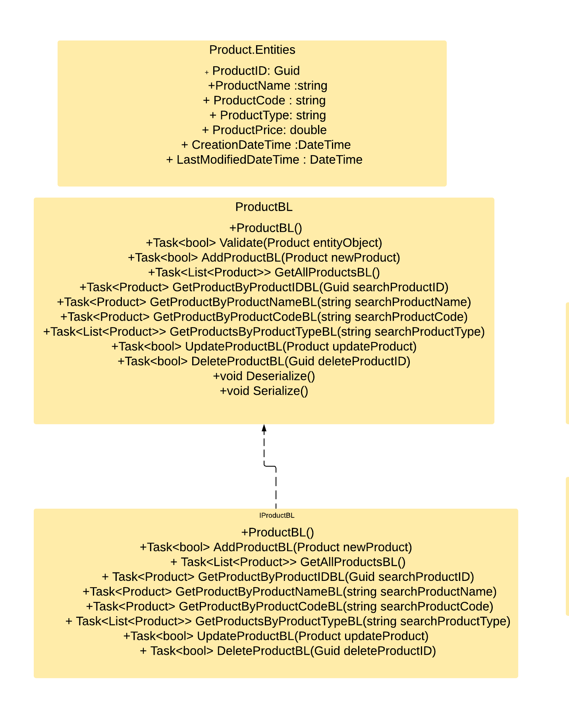
Class Diagram for Product Class

Slide 25
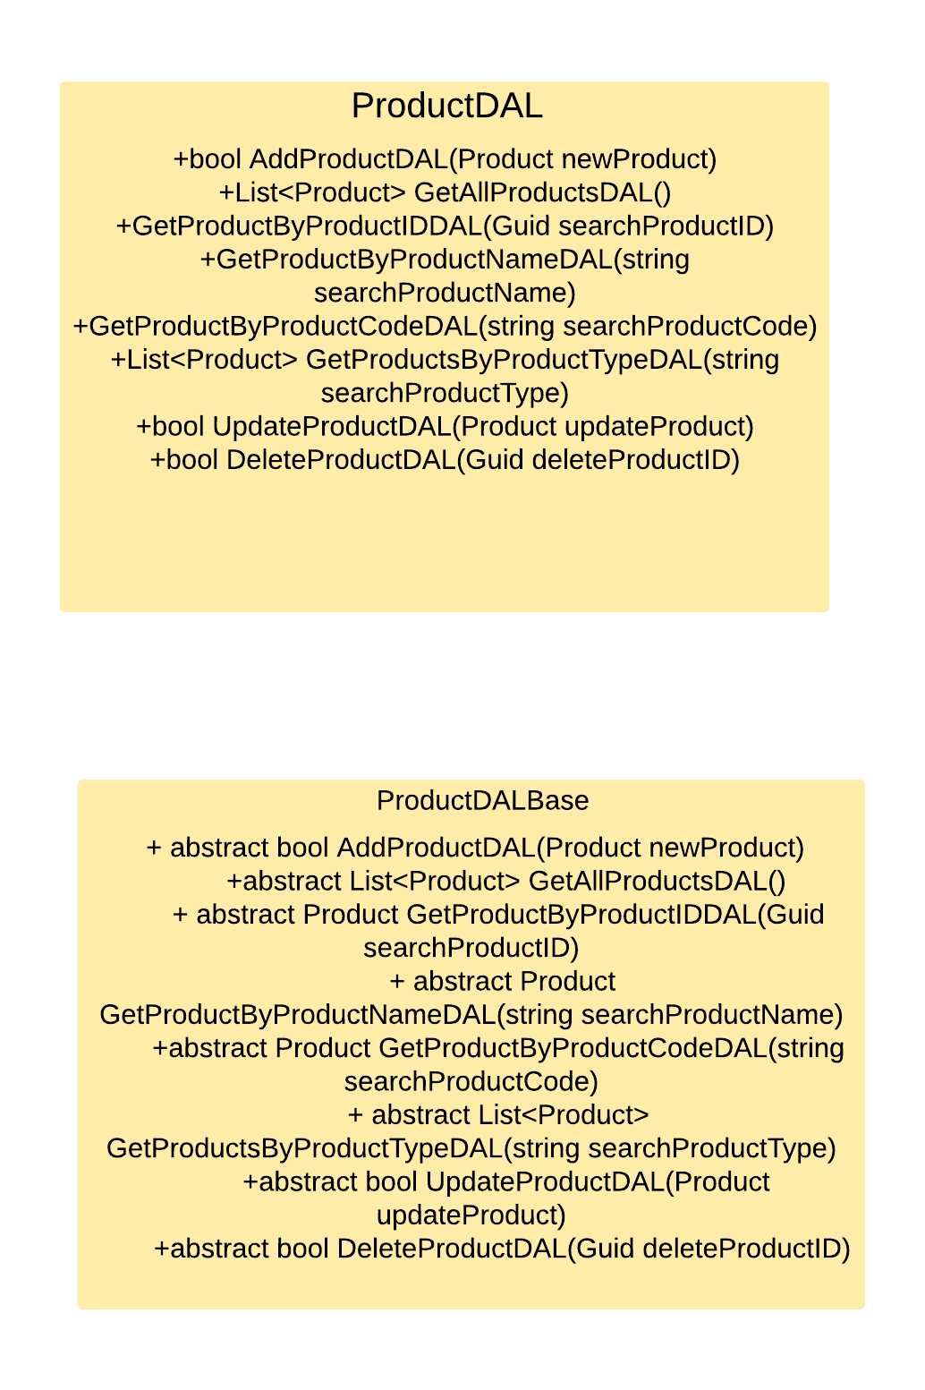
Class Diagram for Product Class

Slide 26
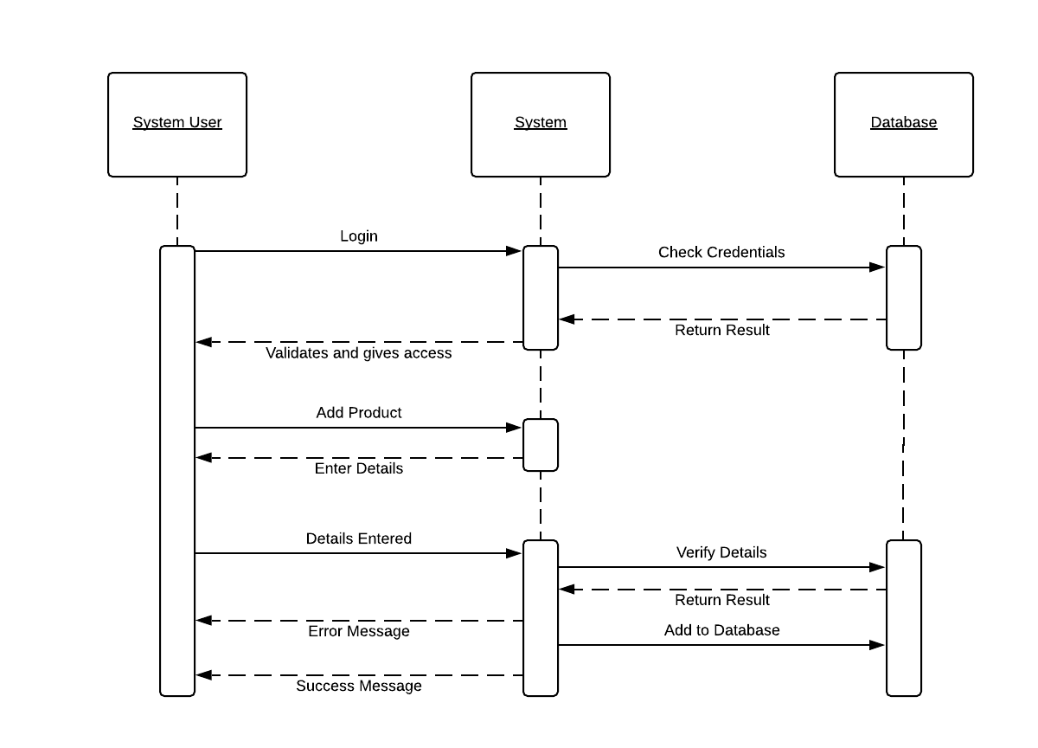
Sequence Diagrams
Sequence Diagram to add product:

Slide 27
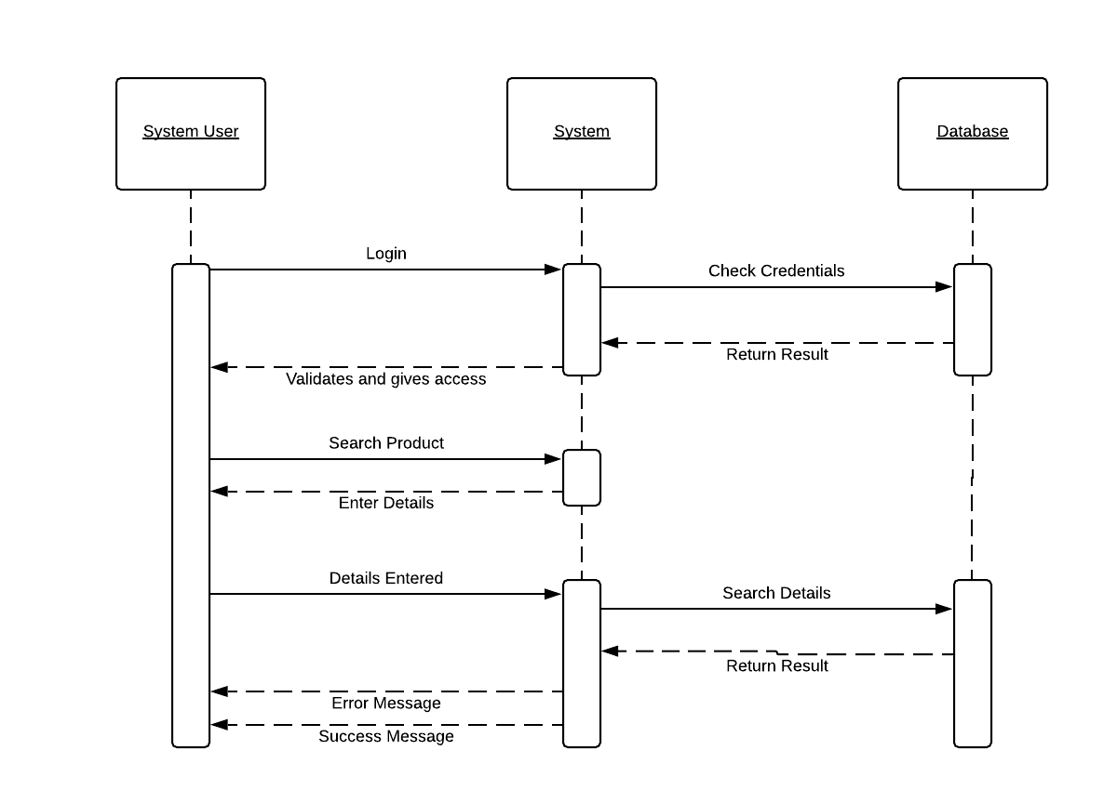
Sequence Diagram to search for product:

Slide 28
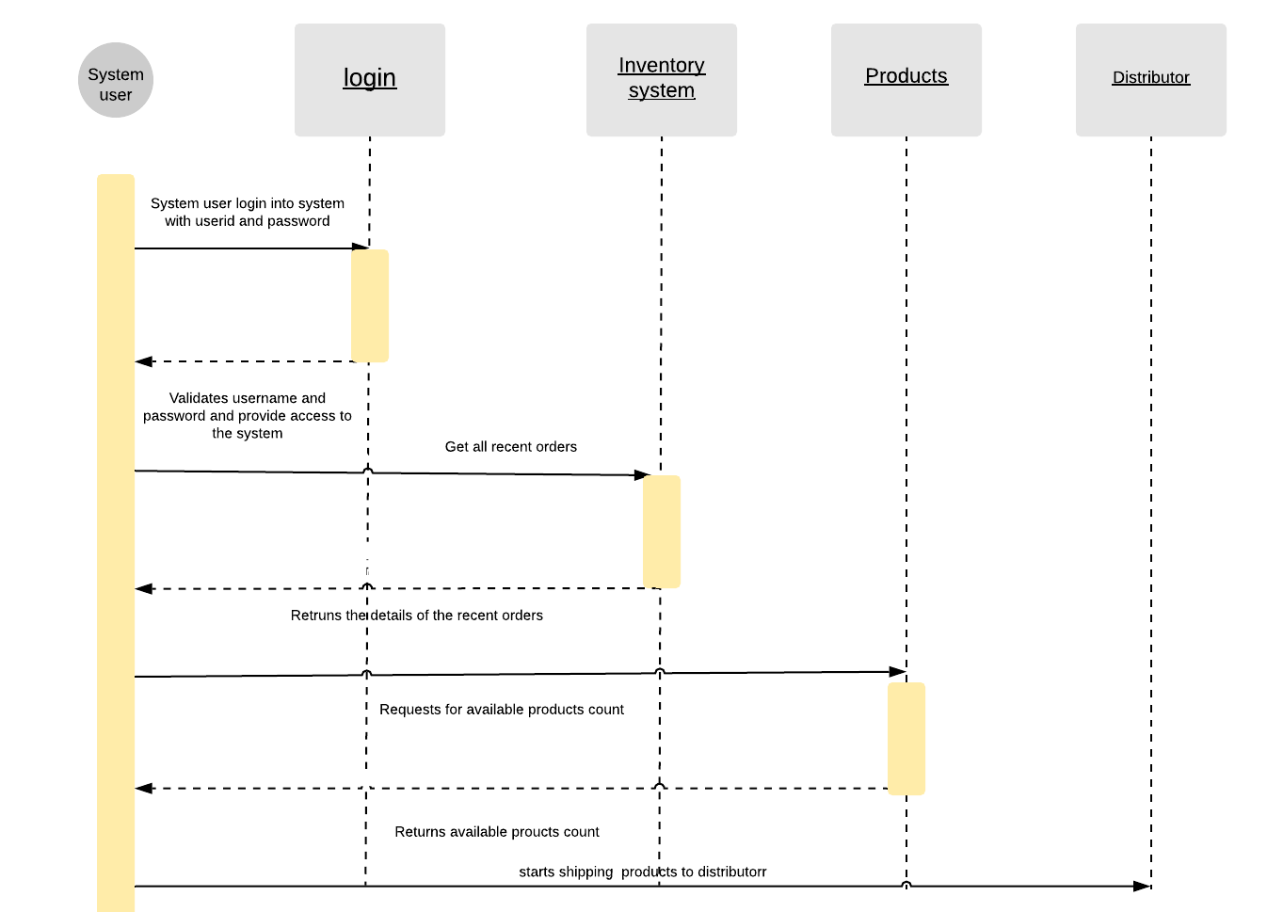
Sequence diagram for order processing by system user

Slide 29
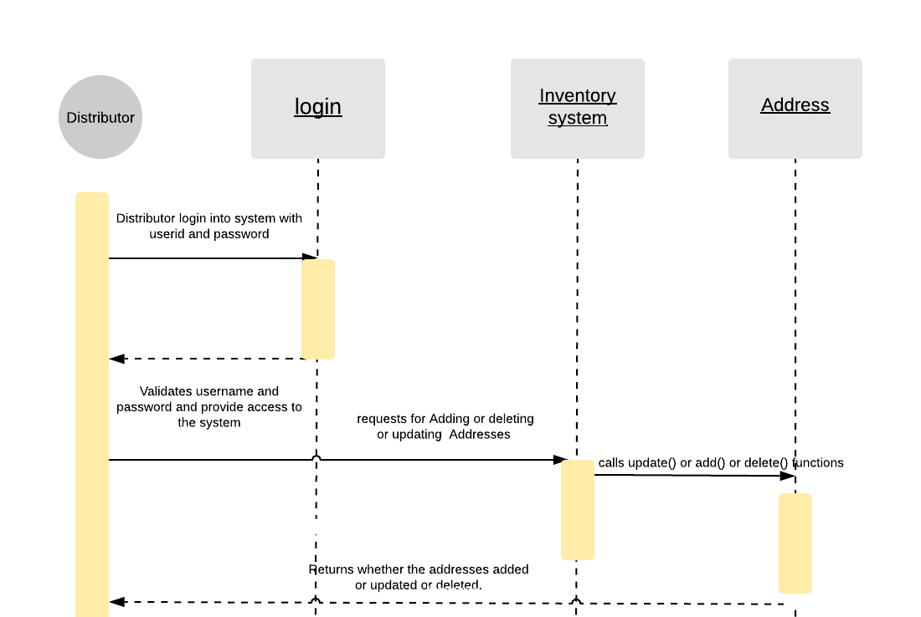
Sequence diagram for managing addresses by the distributor

Slide 30
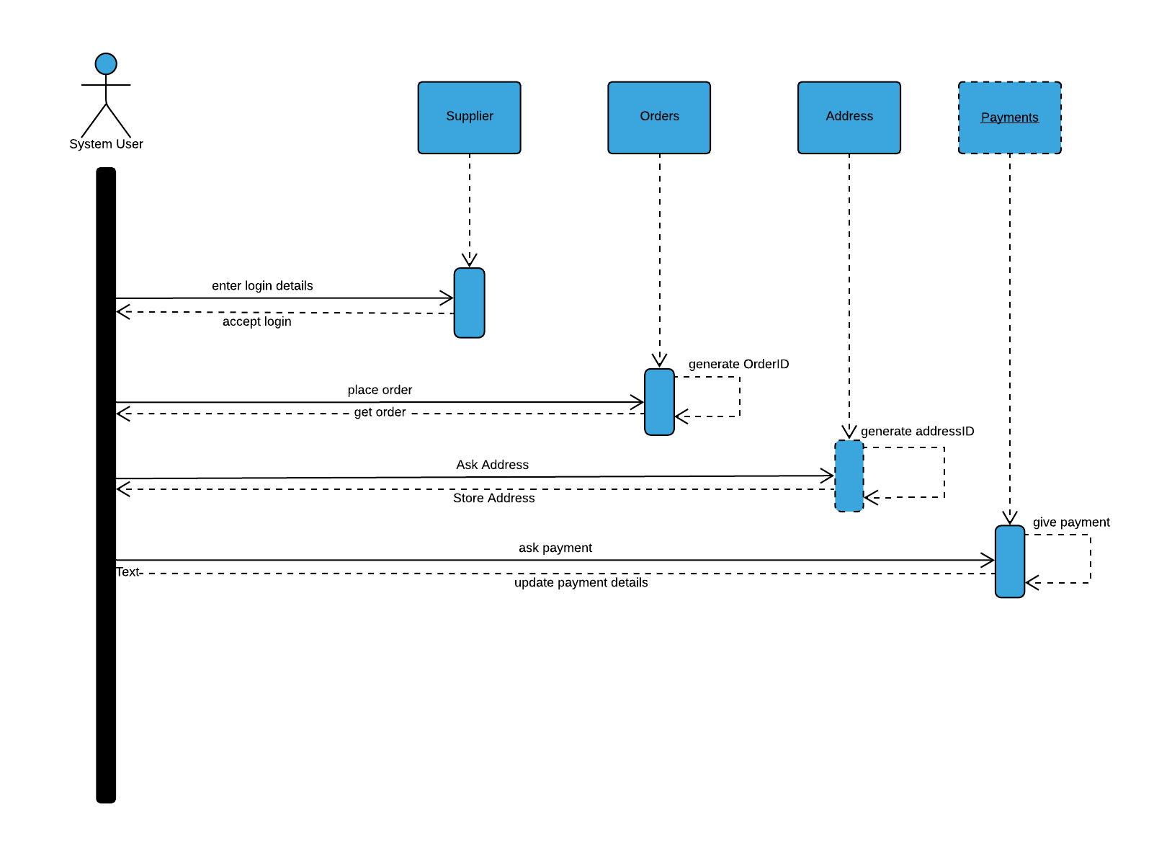
SEQUENCE DIAGRAM SUPPLIER

Slide 31
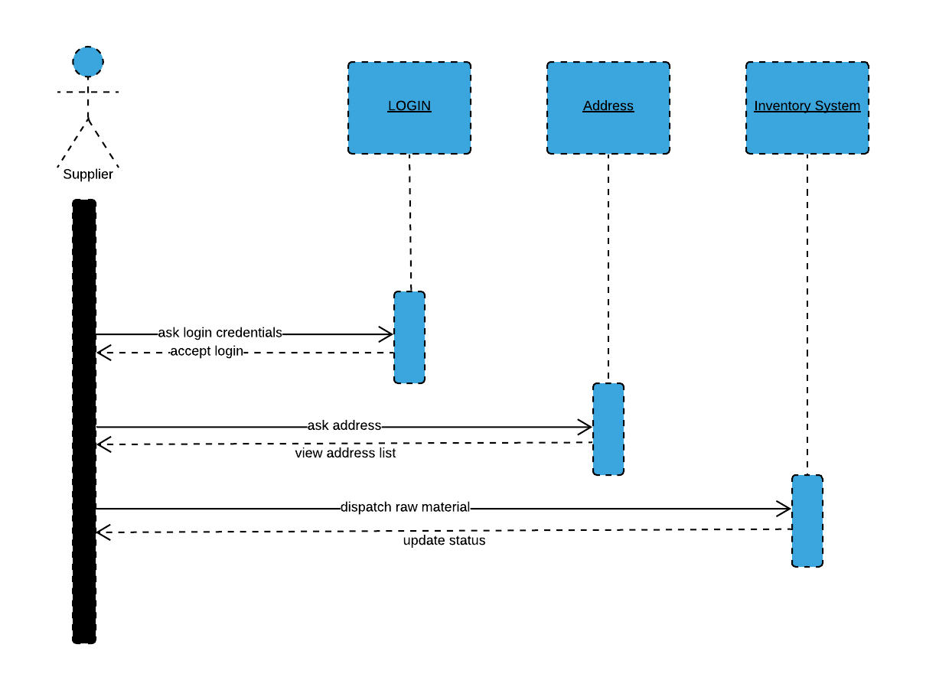
SEQUENCE DIAGRAM ADDRESS SUPPLIER

Slide 32
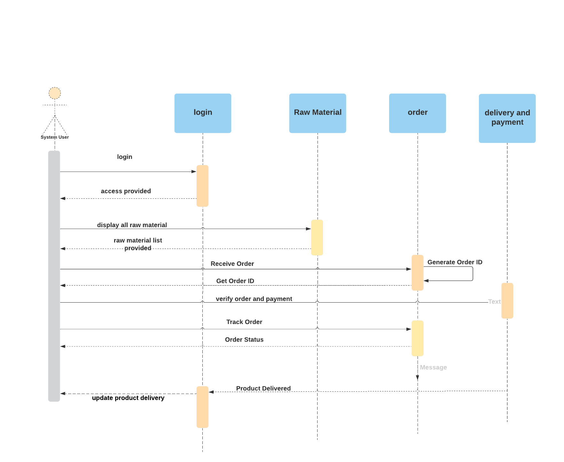
Sequence diagram 1 (raw material order)

Slide 33
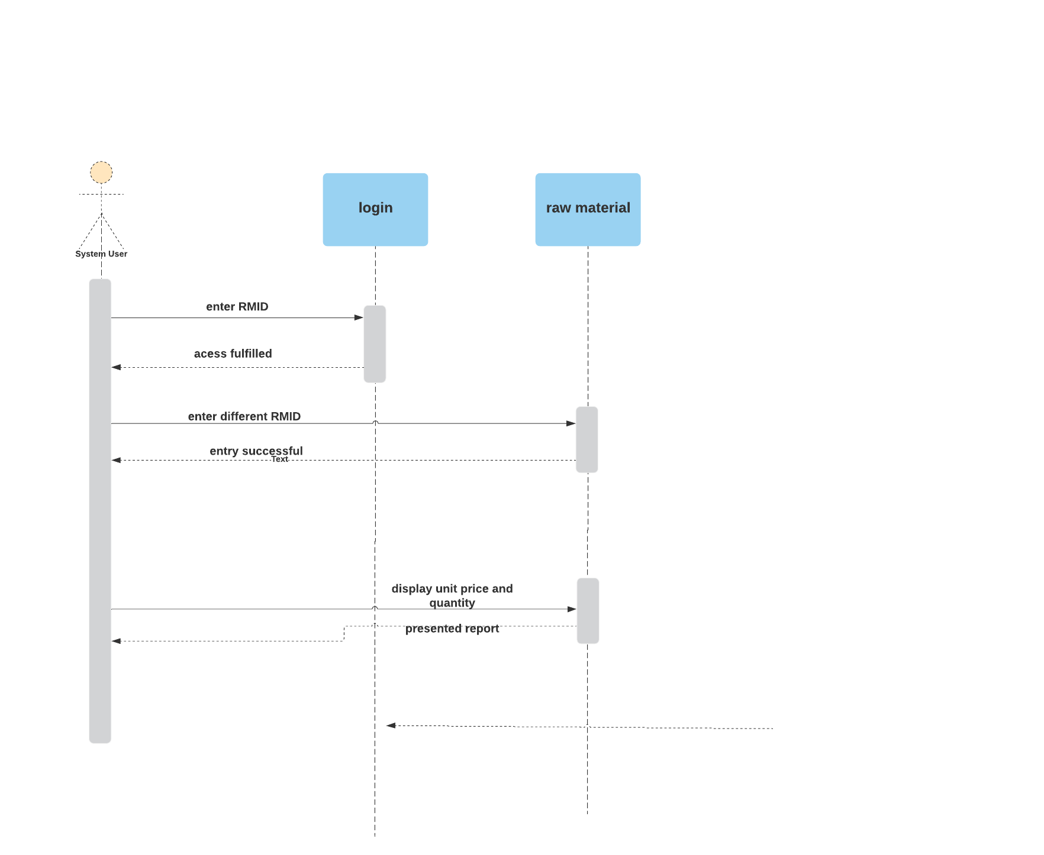

Slide 34
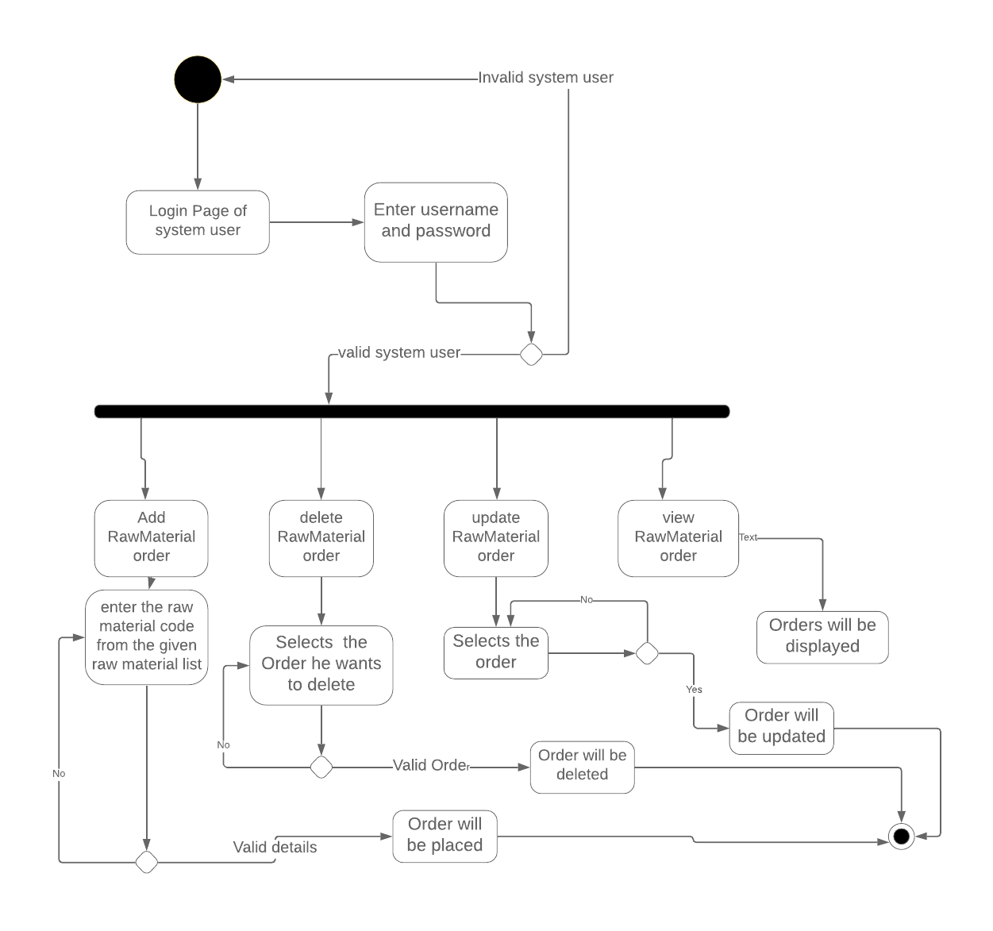
Enter the raw material quantity and price gets calculated

Slide 35
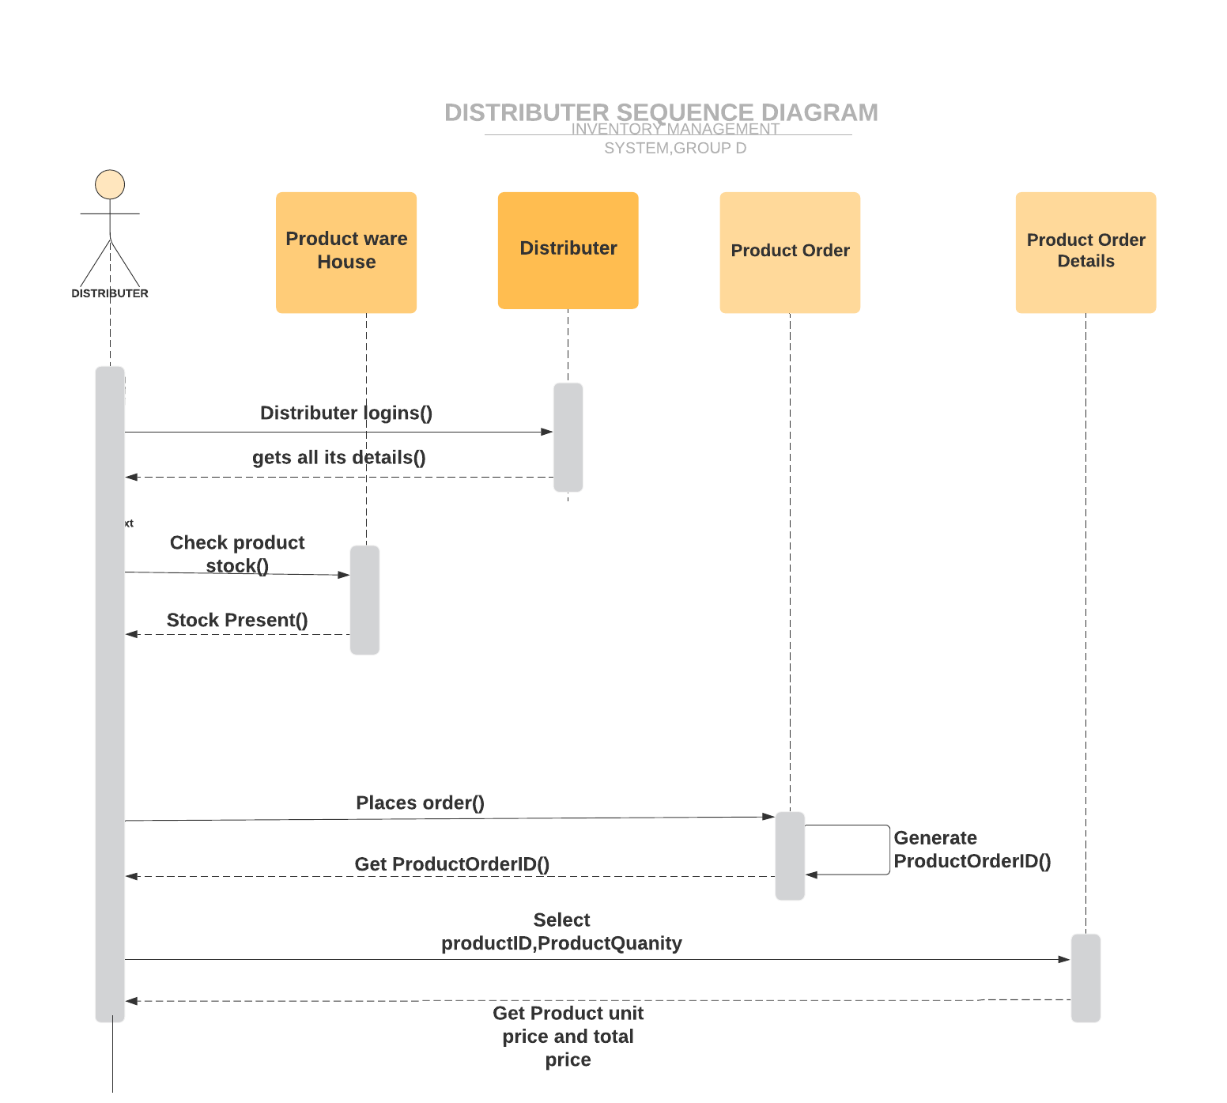

Slide 36
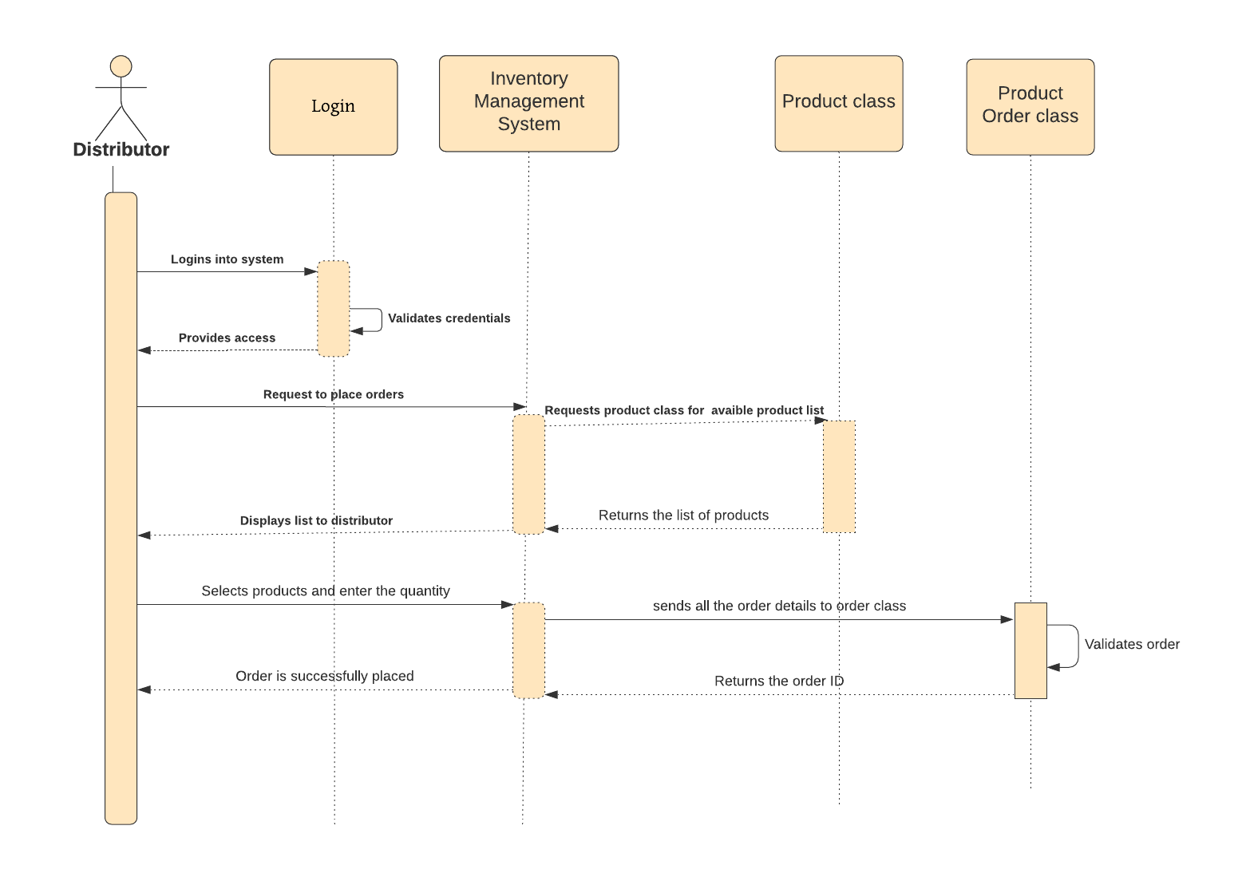

Slide 37
